Slide 1


Ambassadors of Reconciliation
2 Corinthians 5
Jeff Coleman, 9 October 2022

Slide 2
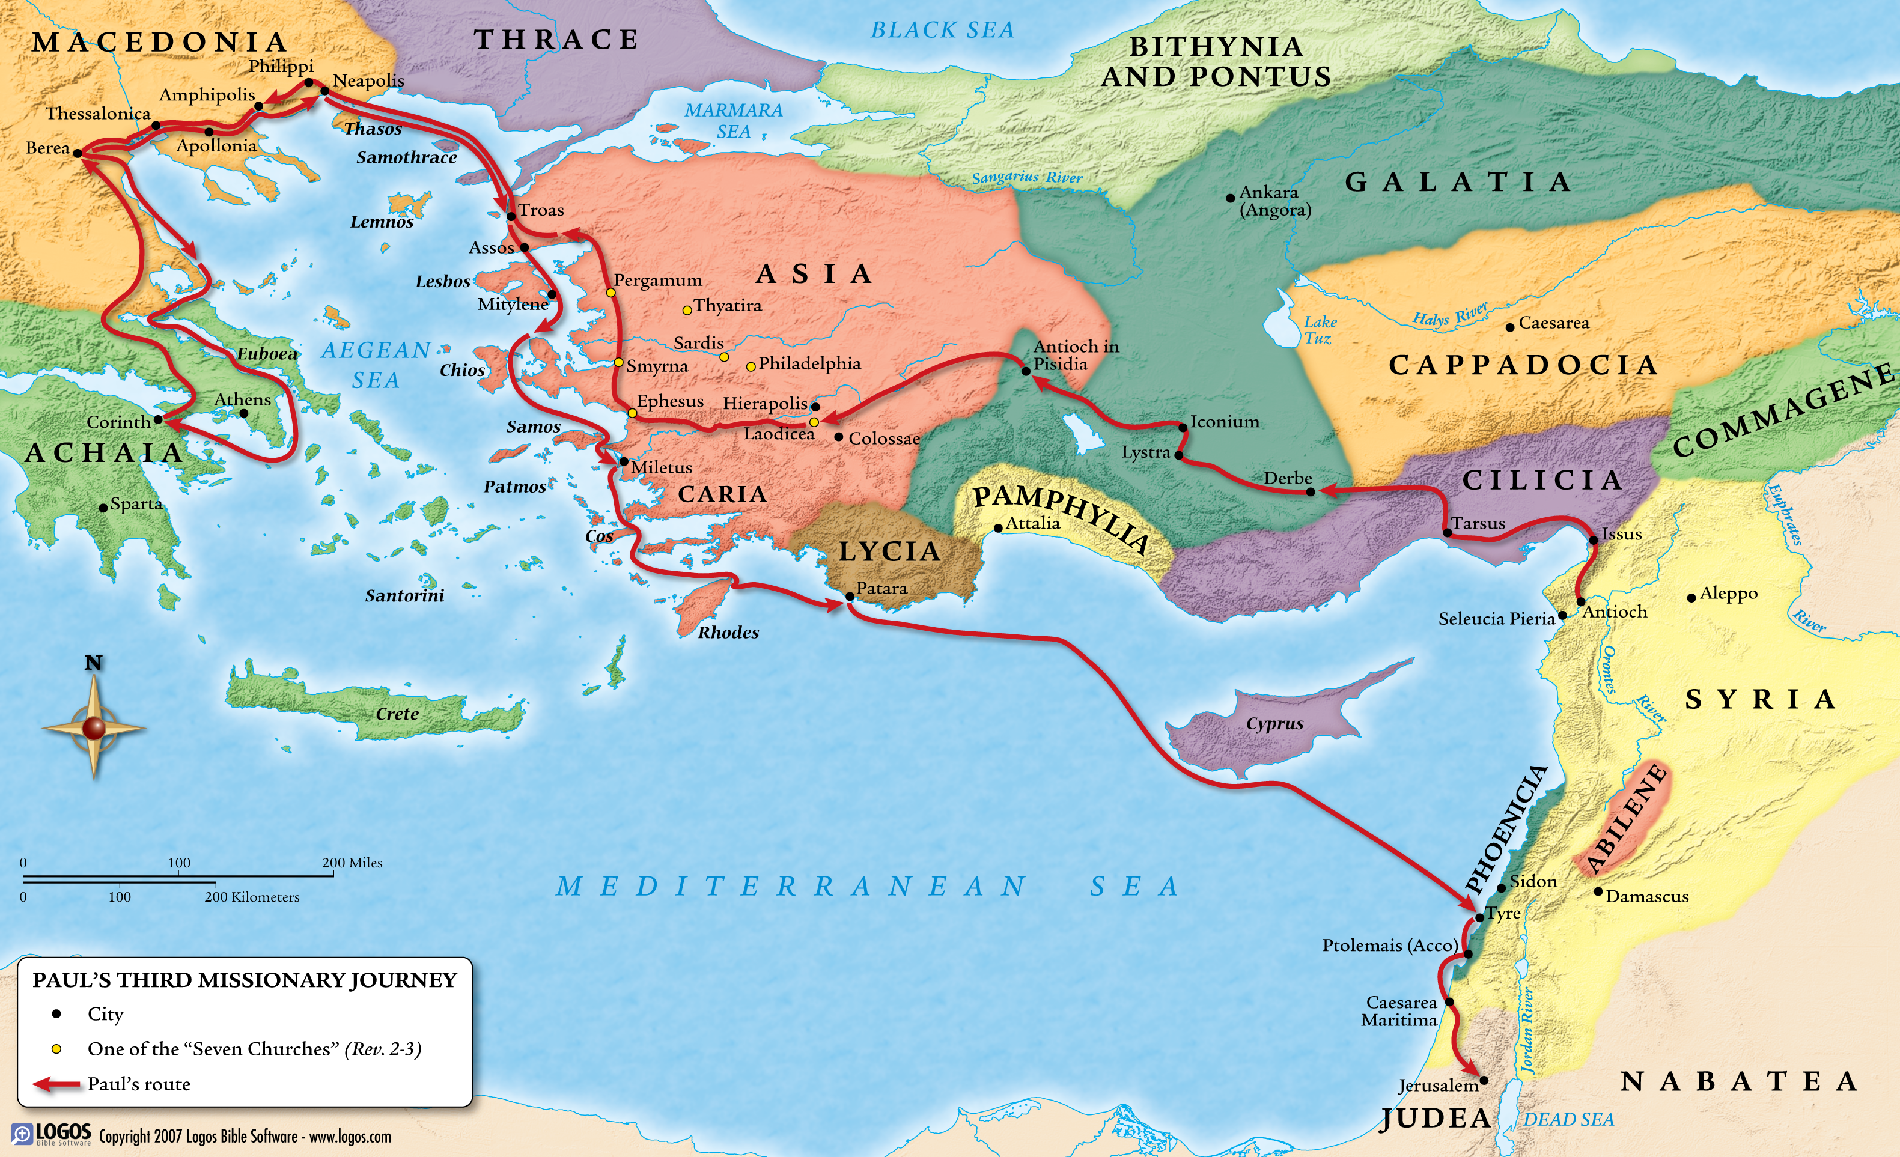

Slide 3
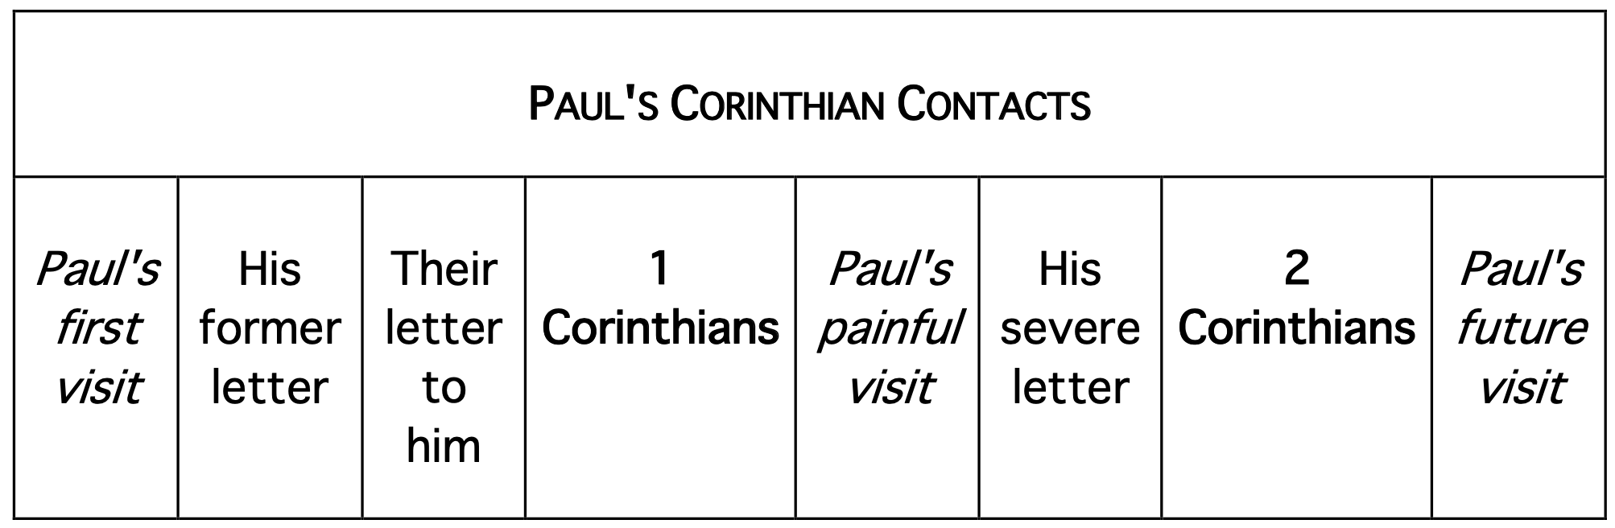

Slide 4

Paul’s Purposes in Writing
2 Corinthians
Encourage the repentant majority (1:3-5).
Explain his changed travel plans (1:16-17).
Complete the financial collection for the saints in Judea (8:7).
Vindicate his apostleship in view of criticisms (11:5).
Prepare for this third visit to Corinth (13:10).
Promote restoration of the rebellious minority (13:9-11).

Slide 5
2 Corinthians at a Glance
Ch. | Section | Sub-Section | Sub-Sub Section | Ch. Themes
1 | Repentent Majority | Explanation: Paul’s Account of His Ministry | Paul’s Motive | Comfort in Affliction
2 |  |  |  | Reaffirm Your Love
3 |  |  | Paul’s Message | Ministers of a New Covenant
4 |  |  |  | Don’t Lose Heart
5 |  |  |  | Ambassadors of Reconciliation
6 |  | Exhortation: Paul’s Appeal to His Converts | On Things Spiritual
7
8 |  |  | On Things Material
9
10 | Rebellious Minority | Vindication: Paul’s Answer to His Critics | The Critics and Their Pretensions The Apostle and His Credentials
11
12
13

Slide 6

2 Corinthians 5

Slide 7
Ambassadors of Reconciliation
2 Corinthians 5
The Mortal Swallowed Up by Life (vv. 1-5)
Always of Good Courage (vv. 6-10)
Guided by Messiah’s Love (vv. 11-15)
Ministers of Reconciliation (vv. 16-21)

Slide 8
The Mortal Swallowed Up by Life
2 Corinthians 5:1-5
1 For we know that if the tent (σκῆνος) that is our earthly home is destroyed, we have a building from God, a house not made with hands, eternal in the heavens. 2 For in this tent we groan (στενάζω), longing (ἐπιποθέω) to put on our heavenly dwelling, 3 if (εἰ) indeed [assumed true for the purpose of argument] by putting it on we will not be found naked (γυμνός). 4 For while we are still in this tent, we groan, being burdened—not that we desire to remove our clothing, but to put on a garment over our existing garment (ἐπενδύομαι), so that what is mortal may be swallowed up by life (ζωή). 5 He who prepared us for this very thing is God, who gave us the guarantee of the Spirit (τὸν ἀρραβῶνα τοῦ πνεύματος).

Slide 9
Always of Good Courage
2 Corinthians 5:6-10
6 So we are always (πάντοτε) of good courage (θαρρέω, pres.). We know that while we are at home in the body we are away from the Lord [Jesus], 7 for we walk (περιπατέω, pres.) by faith (διὰ πίστεως), not by sight. 8 Yes, we are of good courage, and we would rather be away from the body and at home with the Lord [Jesus]. 9 So whether we are at home or away, we make it our aim (φιλοτιμέομαι, pres.) to be pleasing (εὐάρεστος) to him. 10 For we must (δεῖ) all appear before the judgment seat of Messiah (τοῦ βήματος τοῦ Χριστοῦ), so that each one may receive (κομίζω, aor.) what is due for what he has done in the body, whether good (ἀγαθός) or worthless (φαῦλος).

Slide 10

THREE PHASES OF SALVATION
Phase Zero | Phase One | Phase Two | Phase Three
Condemnation | Justification | Sanctification | Glorification
Saved from nothing | Saved from the penalty of sin | Saved from the power of sin | Saved from the presence of sin
Life as an unbeliever | Moment of faith in Jesus | Believer’s lifetime | Eternity future
No faith or works | Faith alone | Faith and works | Works alone

Slide 11
Phase Two:
The Christian Life
Time →
Spiritual Maturity →
Judgment Seat of Messiah Jesus

Slide 12
Phase Two:
The Christian Life
Time →
Spiritual Maturity →
Judgment Seat
Phase Three:
Rewards in Eternity

Slide 13
Guided by Messiah’s Love
2 Corinthians 5:11-15
11 Therefore, knowing the fear (φόβος) of the Lord [Jesus], we go on persuading (πείθω, pres.) others. But what we are has been revealed to God, and I hope it has been revealed also to your conscience. 12 We are not commending ourselves to you again but giving you cause to boast about us, so that you may be able to answer those who boast about outward appearance (ἐν προσώπῳ) and not about what is in the heart (ἐν⸃ καρδίᾳ). 13 For if we are beside ourselves, it is for God. If we are in our right mind, it is for you. 14 For Messiah’s love (ἀγάπη) [for us] guides (συνέχω, pres.) us, because we have concluded this: that one [Jesus] has died in the place of all [people] (εἷς ὑπὲρ πάντων ἀπέθανεν), therefore all [people] have died (οἱ πάντες ἀπέθανον) [potentially in him]. 15 And he died in the place of all [people] (ὑπὲρ πάντων ἀπέθανεν), in order that those who live (οἱ ζῶντες) [believers] might no longer live (ζάω, pres. subj.) for themselves but for him [Jesus] who in their place (ὑπὲρ αὐτῶν) died and was raised.

Slide 14
Ministers of Reconciliation
2 Corinthians 5:16-21
16 From now on, therefore, we regard no one according to the flesh. Even though we once regarded Messiah according to the flesh, we regard him thus no longer. 17 Therefore, if anyone is in Messiah (ἐν Χριστῷ), he is a new creation (καινὴ κτίσις). The old passed away. Behold, the new (καινά) has come. 18 All this is from the God who reconciled us to himself though Messiah and gave us the ministry of reconciliation. 19 That is, God was in Messiah reconciling the world (κόσμος) [of men] to himself, not counting (λογίζομαι, pres.) their [personal] trespasses against them, and entrusting to us the message of reconciliation (τὸν λόγον⸃ τῆς καταλλαγῆς). 20 Therefore, on behalf of Messiah we are ambassadors, God making his appeal through us. We ask you on behalf of Messiah, be reconciled to God. 21 For our sake (ὑπὲρ ἡμῶν) he [God] made him [Jesus] to be sin who knew no sin, in order that we might become (γίνομαι) the righteousness (δικαιοσύνη) of God in him.

Slide 15
Reconciliation of All Things
Colossians 1:19-23
19 For in [the Son, Jesus] all the fulness of God was pleased to dwell, 20 and through him to reconcile to himself all things, whether on earth or in heaven, making peace by the blood of his cross. 21 And you [believers], who once were alienated and hostile in mind, doing evil deeds [in phase zero], 22 he has now reconciled in his body of flesh by his death [in phase one], in order to present you [in phase three] holy, blameless, and above reproach before him, 23 if (εἰ) indeed [in phase two] you continue in the [Christian] faith [doctrine/theology], stable and steadfast, not shifting from the hope of the gospel [message] that you heard, which has been proclaimed in all creation under heaven, and of which I, Paul, became a minister.

Slide 16
Bearing shame and scoffing rude,
In my place condemned He stood;
Sealed my pardon with His blood.
Hallelujah! What a Savior!

Slide 17

Application
2 Corinthians 5
Be reconciled to God (v. 21).
Be of good courage (vv, 6, 8).
Walk by faith, not by sight (v. 7).
Make it your aim to please Jesus (v. 9).
Be guided by Jesus’ love for us (v. 14).
Be an ambassador for Jesus (v. 20).
Long to put on your heavenly dwelling (v. 2).

